Slide 1
ZCE 111 Computational Physics Semester Project
Ng Wei Chun, 105525
Solving the Schrödinger equation for
Helium Atom with
Hatree-Fock Method

Slide 2
Helium Ground State with
Gaussian s-basis Function

Slide 3
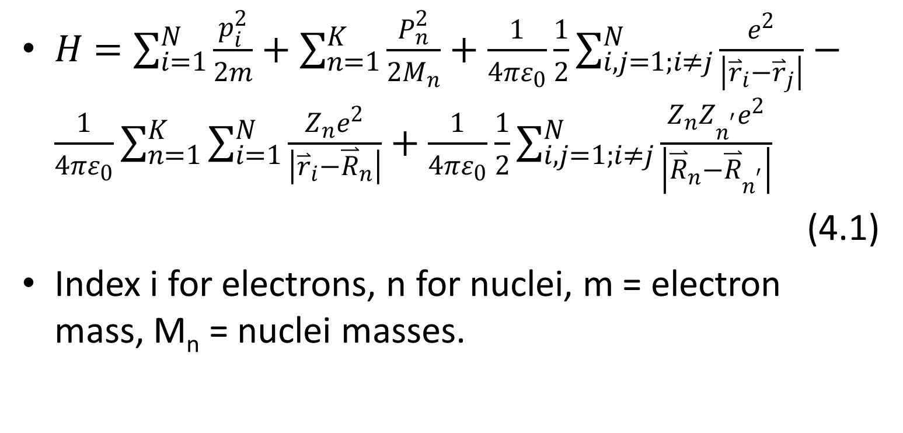
Hamiltonian of a system of N electrons, K nuclei, with Z_{n} charges
$H=\sum_{i=1}^{N}{\frac{p_{i}^{2}}{2m}}+\sum_{n=1}^{K}{\frac{P_{n}^{2}}{2M_{n}}}+\frac{1}{4πε_{0}}\frac{1}{2}\sum_{i,j=1;i≠j}^{N}{\frac{e^{2}}{\left|{\overset{⃑}{r}}_{i}−{\overset{⃑}{r}}_{j}\right|}}−\frac{1}{4πε_{0}}\sum_{n=1}^{K}{\sum_{i=1}^{N}{\frac{Z_{n}e^{2}}{\left|{\overset{⃑}{r}}_{i}−{\overset{⃑}{R}}_{n}\right|}}}+\frac{1}{4πε_{0}}\frac{1}{2}\sum_{i,j=1;i≠j}^{N}{\frac{Z_{n}Z_{n^{′}}e^{2}}{\left|{\overset{⃑}{R}}_{n}−{\overset{⃑}{R}}_{n^{′}}\right|}}$
(4.1)
Index i for electrons, n for nuclei, m = electron mass, M_{n} = nuclei masses.

Slide 4
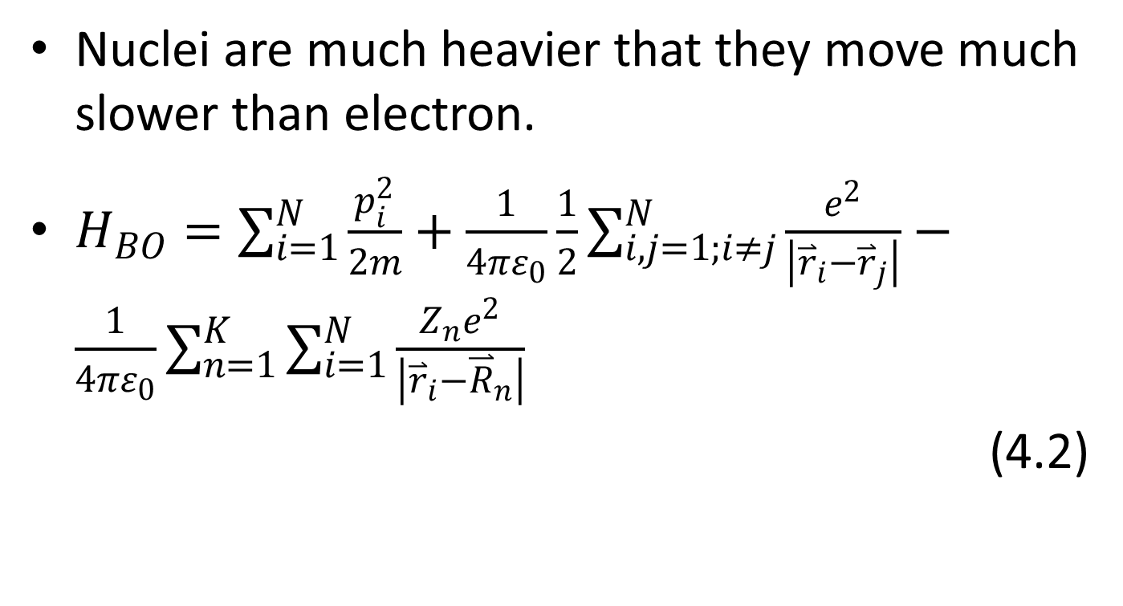
Born-Oppenheimer approximation
Nuclei are much heavier that they move much slower than electron.
$H_{BO}=\sum_{i=1}^{N}{\frac{p_{i}^{2}}{2m}}+\frac{1}{4πε_{0}}\frac{1}{2}\sum_{i,j=1;i≠j}^{N}{\frac{e^{2}}{\left|{\overset{⃑}{r}}_{i}−{\overset{⃑}{r}}_{j}\right|}}−\frac{1}{4πε_{0}}\sum_{n=1}^{K}{\sum_{i=1}^{N}{\frac{Z_{n}e^{2}}{\left|{\overset{⃑}{r}}_{i}−{\overset{⃑}{R}}_{n}\right|}}}$
(4.2)

Slide 5
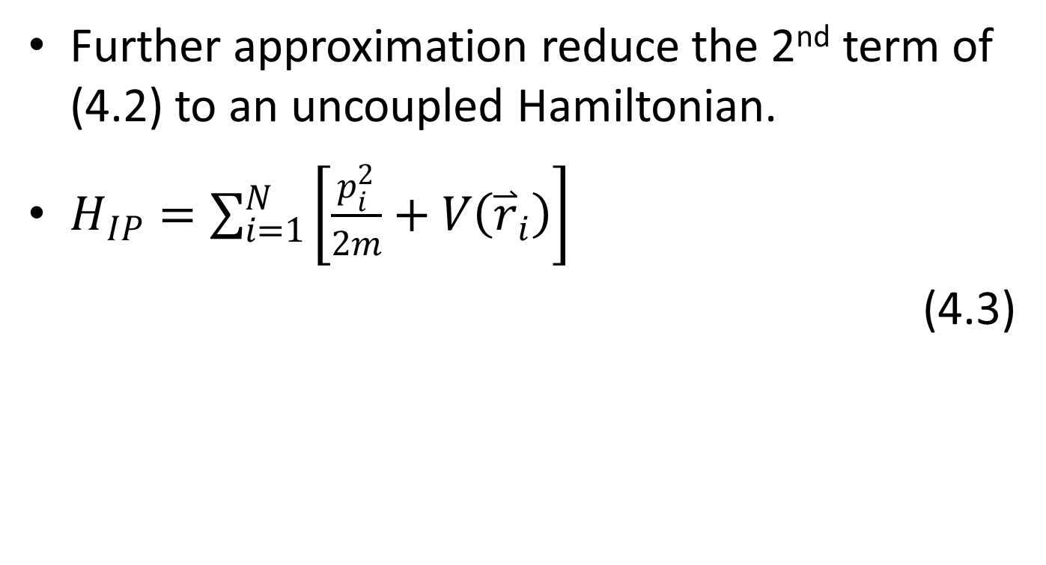
The independent-particle (IP) Hamiltonian
Further approximation reduce the 2nd term of (4.2) to an uncoupled Hamiltonian.
$H_{IP}=\sum_{i=1}^{N}{\left[\frac{p_{i}^{2}}{2m}+V\left({\overset{⃑}{r}}_{i}\right)\right]}$
(4.3)

Slide 6
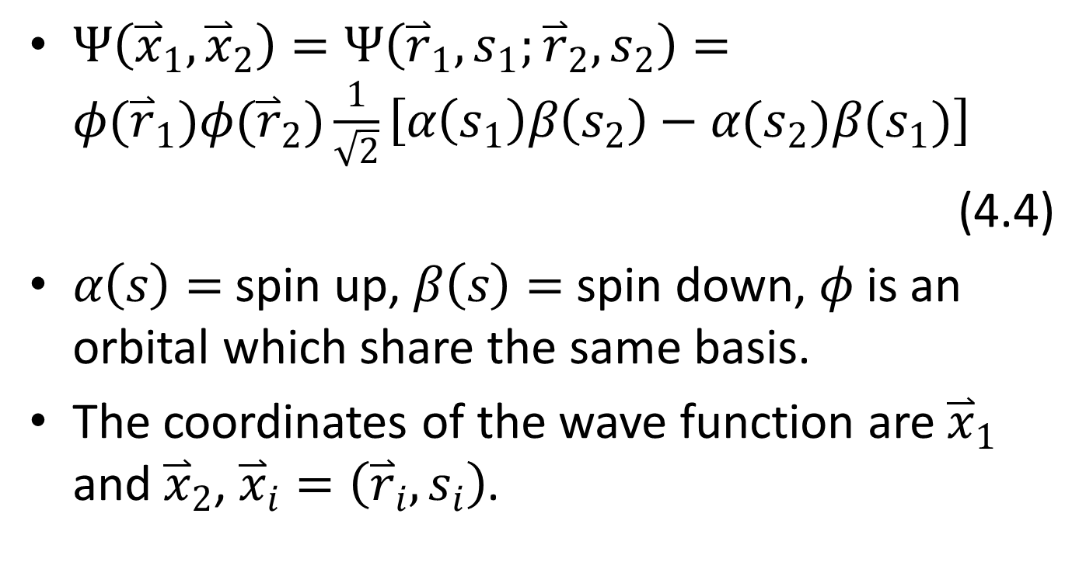
Anti-symmetric trial wave function for ground state
$Ψ\left({\overset{⃑}{x}}_{1},{\overset{⃑}{x}}_{2}\right)=Ψ\left({\overset{⃑}{r}}_{1},s_{1};{\overset{⃑}{r}}_{2},s_{2}\right)=φ({\overset{⃑}{r}}_{1})φ({\overset{⃑}{r}}_{2})\frac{1}{\sqrt{2}}\left[α\left(s_{1}\right)β\left(s_{2}\right)−α(s_{2})β(s_{1})\right]$
(4.4)
$α\left(s\right)=$ spin up, $β\left(s\right)=$ spin down, $φ$ is an orbital which share the same basis.
The coordinates of the wave function are ${\overset{⃑}{x}}_{1}$ and ${\overset{⃑}{x}}_{2}$, ${\overset{⃑}{x}}_{i}=\left({\overset{⃑}{r}}_{i},s_{i}\right)$.

Slide 7
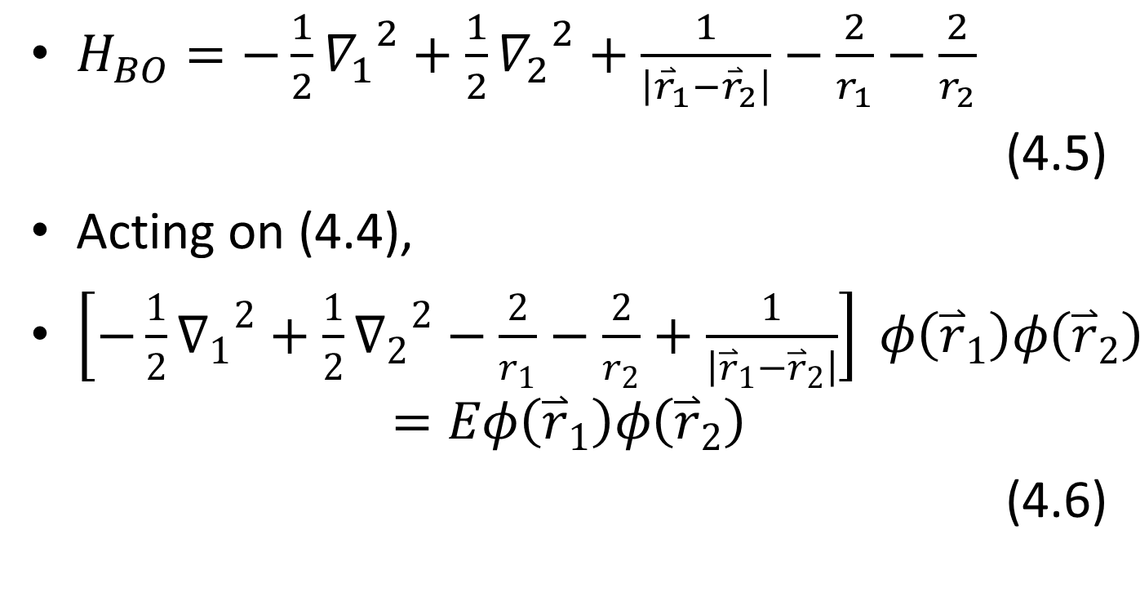
Born-Oppenheimer Hamiltonian for the helium atom
$H_{BO}=−\frac{1}{2}{∇_{1}}^{2}+\frac{1}{2}{∇_{2}}^{2}+\frac{1}{\left|{\overset{⃑}{r}}_{1}−{\overset{⃑}{r}}_{2}\right|}−\frac{2}{r_{1}}−\frac{2}{r_{2}}$
(4.5)
Acting on (4.4),
$\left[−\frac{1}{2}{∇_{1}}^{2}+\frac{1}{2}{∇_{2}}^{2}−\frac{2}{r_{1}}−\frac{2}{r_{2}}+\frac{1}{\left|{\overset{⃑}{r}}_{1}−{\overset{⃑}{r}}_{2}\right|}\right] φ\left({\overset{⃑}{r}}_{1}\right)φ\left({\overset{⃑}{r}}_{2}\right)$
$$=Eφ\left({\overset{⃑}{r}}_{1}\right)φ\left({\overset{⃑}{r}}_{2}\right)$$
(4.6)

Slide 8
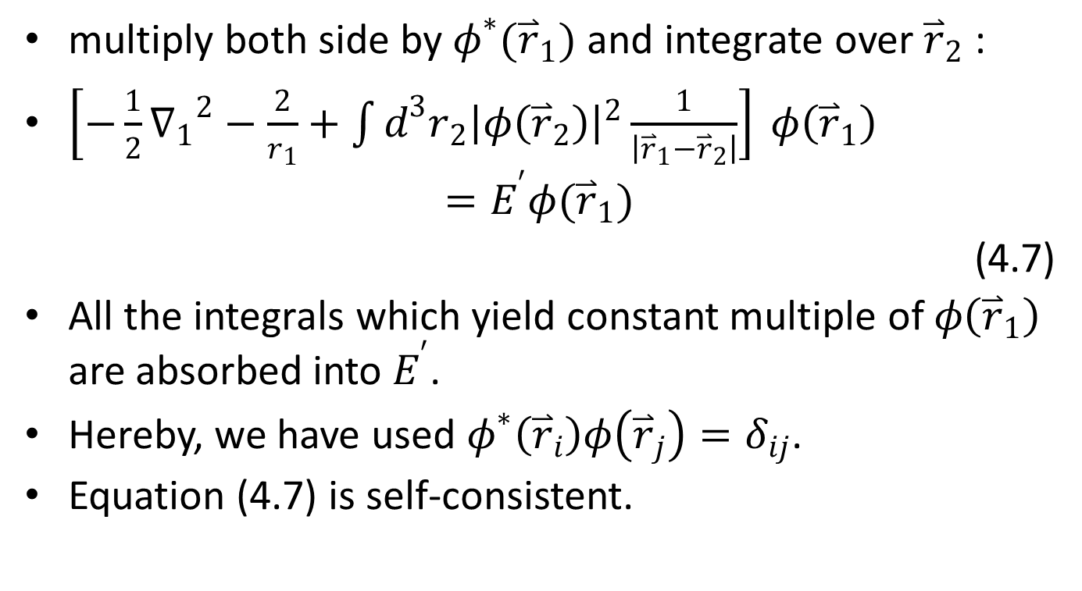
multiply both side by $φ^{∗}({\overset{⃑}{r}}_{1})$ and integrate over ${\overset{⃑}{r}}_{2}$ :
$\left[−\frac{1}{2}{∇_{1}}^{2}−\frac{2}{r_{1}}+\int{d^{3}r_{2}{\left|φ\left({\overset{⃑}{r}}_{2}\right)\right|}^{2}\frac{1}{\left|{\overset{⃑}{r}}_{1}−{\overset{⃑}{r}}_{2}\right|}}\right] φ\left({\overset{⃑}{r}}_{1}\right)$
$$=E^{′}φ({\overset{⃑}{r}}_{1})$$
(4.7)
All the integrals which yield constant multiple of $φ\left({\overset{⃑}{r}}_{1}\right)$ are absorbed into $E^{′}$.
Hereby, we have used $φ^{∗}\left({\overset{⃑}{r}}_{i}\right)φ\left({\overset{⃑}{r}}_{j}\right)=δ_{ij}$.
Equation (4.7) is self-consistent.

Slide 9
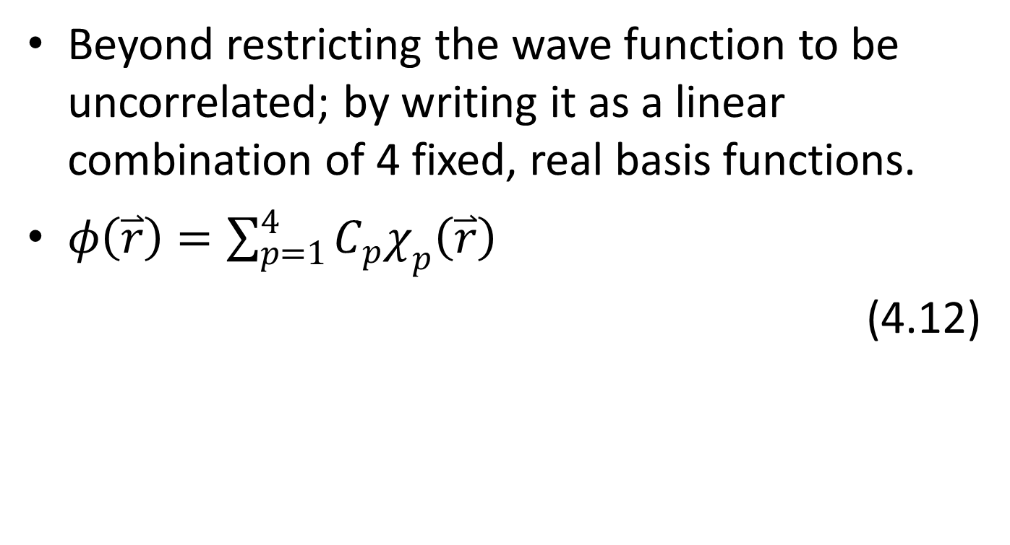
Basis functions
Beyond restricting the wave function to be uncorrelated; by writing it as a linear combination of 4 fixed, real basis functions.
$φ\left(\overset{⃑}{r}\right)=\sum_{p=1}^{4}{C_{p}χ_{p}\left(\overset{⃑}{r}\right)}$
(4.12)

Slide 10

Leads directly from (4.7) that:
$\left[−\frac{1}{2}{∇_{1}}^{2}−\frac{2}{r_{1}}+\sum_{r,s=1}^{N}{C_{r}C_{s}\int{d^{3}r_{2}χ_{r}\left({\overset{⃑}{r}}_{2}\right)χ_{s}\left({\overset{⃑}{r}}_{2}\right)\frac{1}{\left|{\overset{⃑}{r}}_{1}−{\overset{⃑}{r}}_{2}\right|}}}\right] \sum_{q=1}^{4}{C_{q}χ_{q}\left({\overset{⃑}{r}}_{1}\right)}$
$$=E^{′} \sum_{q=1}^{4}{C_{q}χ_{q}\left({\overset{⃑}{r}}_{1}\right)}$$
(4.13)

Slide 11
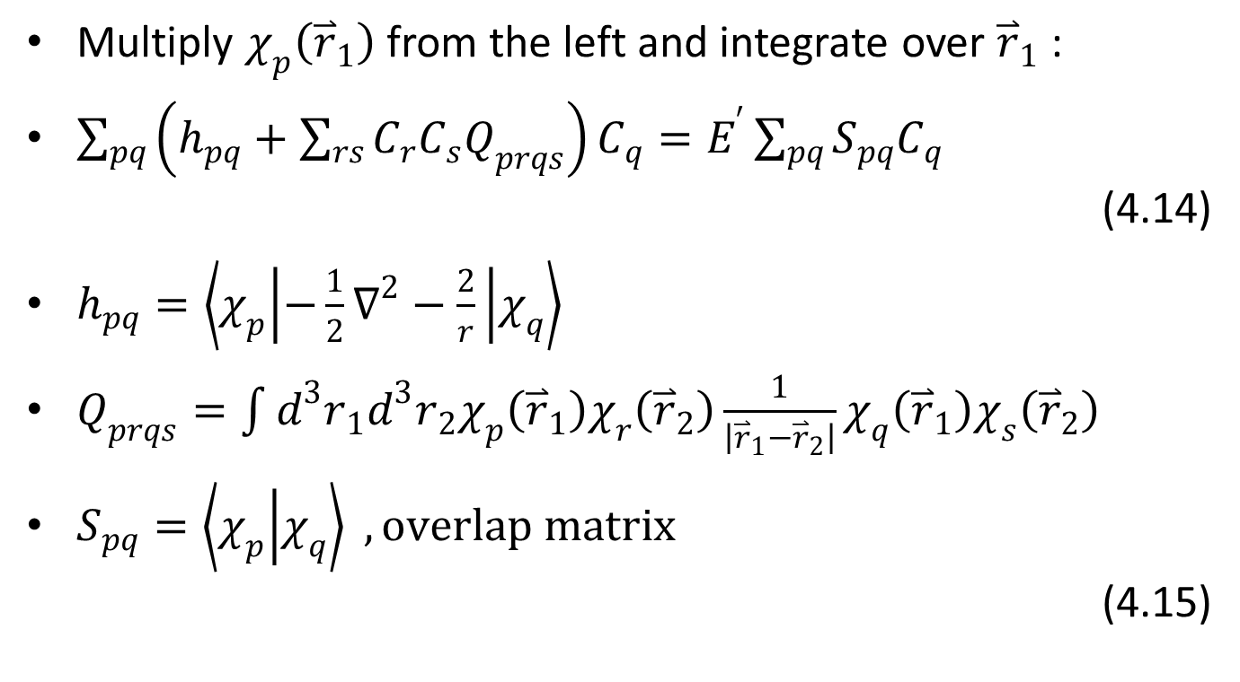
Multiply $χ_{p}\left({\overset{⃑}{r}}_{1}\right)$ from the left and integrate over ${\overset{⃑}{r}}_{1}$ :
$\sum_{pq}{\left(h_{pq}+\sum_{rs}{C_{r}C_{s}Q_{prqs}}\right)C_{q}}=E^{′}\sum_{pq}{S_{pq}C_{q}}$
(4.14)
$h_{pq}=\left\langle χ_{p} | −\frac{1}{2}∇^{2}−\frac{2}{r} | χ_{q}\right\rangle$
$Q_{prqs}=\int{d^{3}r_{1}d^{3}r_{2}χ_{p}\left({\overset{⃑}{r}}_{1}\right)χ_{r}\left({\overset{⃑}{r}}_{2}\right)\frac{1}{\left|{\overset{⃑}{r}}_{1}−{\overset{⃑}{r}}_{2}\right|}χ_{q}\left({\overset{⃑}{r}}_{1}\right)χ_{s}\left({\overset{⃑}{r}}_{2}\right)}$
$S_{pq}=\left\langle χ_{p} | χ_{q}\right\rangle , overlap matrix$
(4.15)

Slide 12
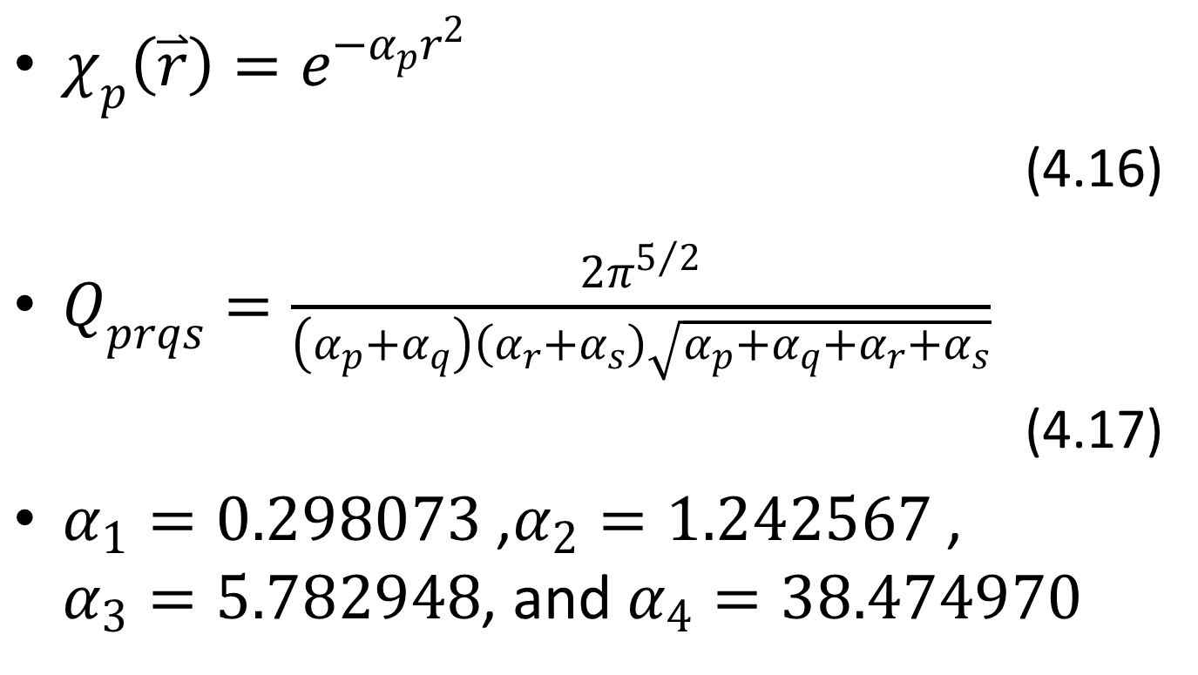

$$\text{Gaussian} \text{s}\text{−}\text{basis} \text{function}$$
$χ_{p}\left(\overset{⃑}{r}\right)=e^{−α_{p}r^{2}}$
(4.16)
$Q_{prqs}=\frac{2π^{5/2}}{\left(α_{p}+α_{q}\right)\left(α_{r}+α_{s}\right)\sqrt{α_{p}+α_{q}+α_{r}+α_{s}}}$
(4.17)
$α_{1}=0.298073$ ,$α_{2}=1.242567$ , $α_{3}=5.782948$, and $α_{4}=38.474970$

Slide 13
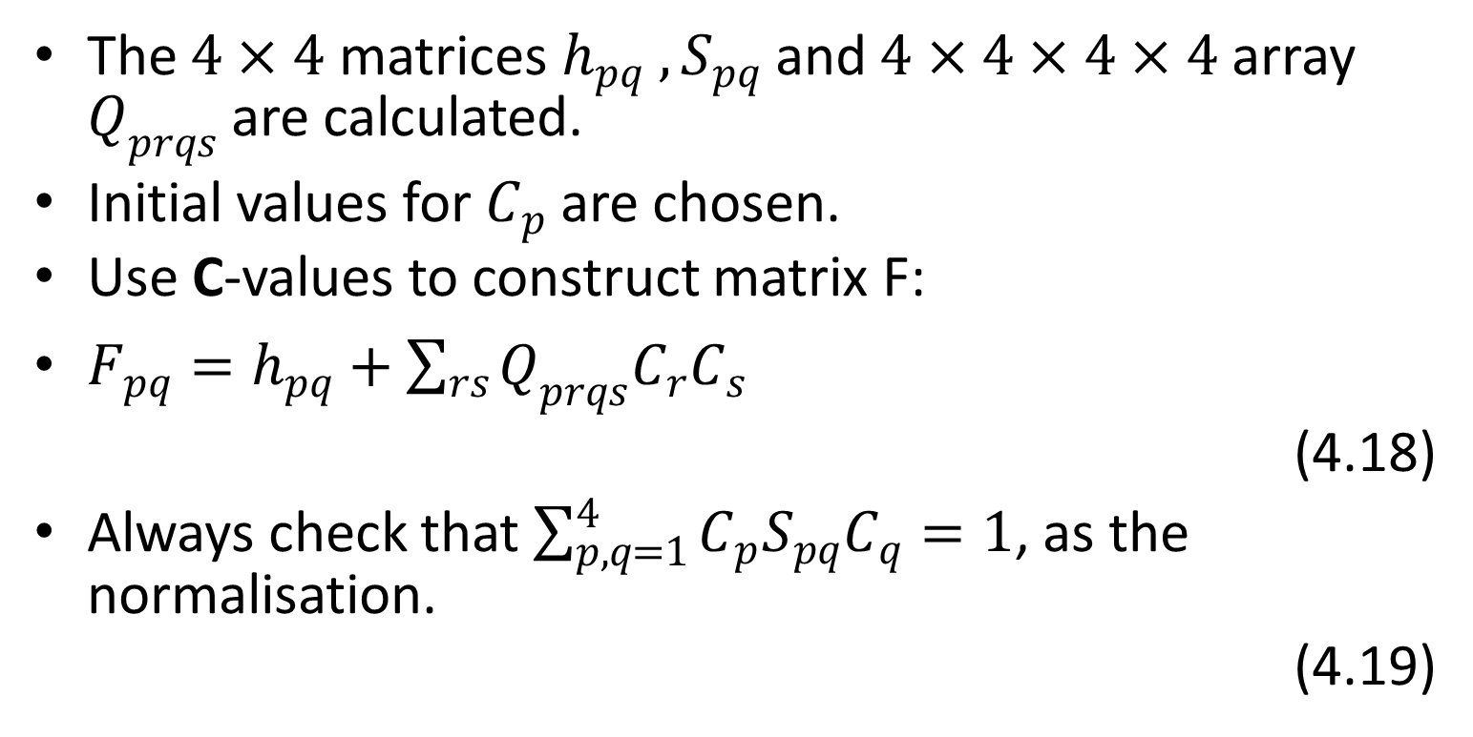
Program flow
The $4×4$ matrices $h_{pq} , S_{pq}$ and $4×4×4×4$ array $Q_{prqs}$ are calculated.
Initial values for $C_{p}$ are chosen.
Use C-values to construct matrix F:
$F_{pq}=h_{pq}+\sum_{rs}{Q_{prqs}C_{r}C_{s}}$
(4.18)
Always check that $\sum_{p,q=1}^{4}{C_{p}S_{pq}C_{q}}=1$, as the normalisation.
(4.19)

Slide 14
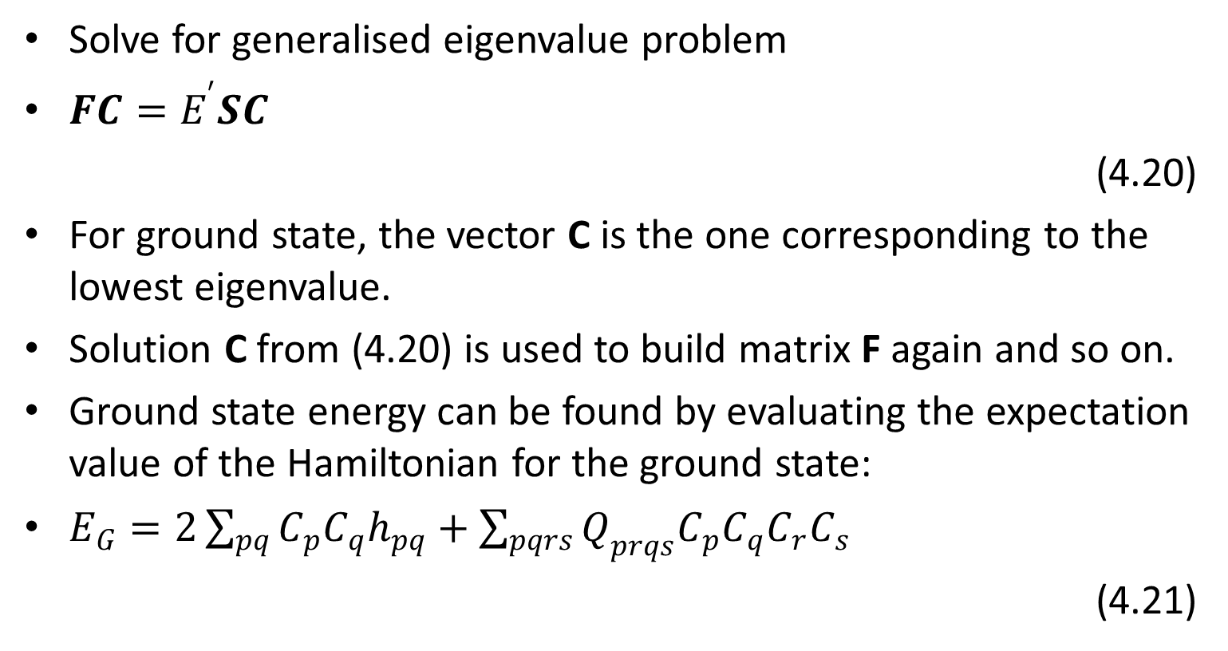
Solve for generalised eigenvalue problem
$FC=E^{′}SC$
(4.20)
For ground state, the vector C is the one corresponding to the lowest eigenvalue.
Solution C from (4.20) is used to build matrix F again and so on.
Ground state energy can be found by evaluating the expectation value of the Hamiltonian for the ground state:
$E_{G}=2\sum_{pq}{C_{p}C_{q}h_{pq}}+\sum_{pqrs}{Q_{prqs}C_{p}C_{q}C_{r}C_{s}}$
(4.21)

Slide 16
General Hartree-Fock Method

Slide 17
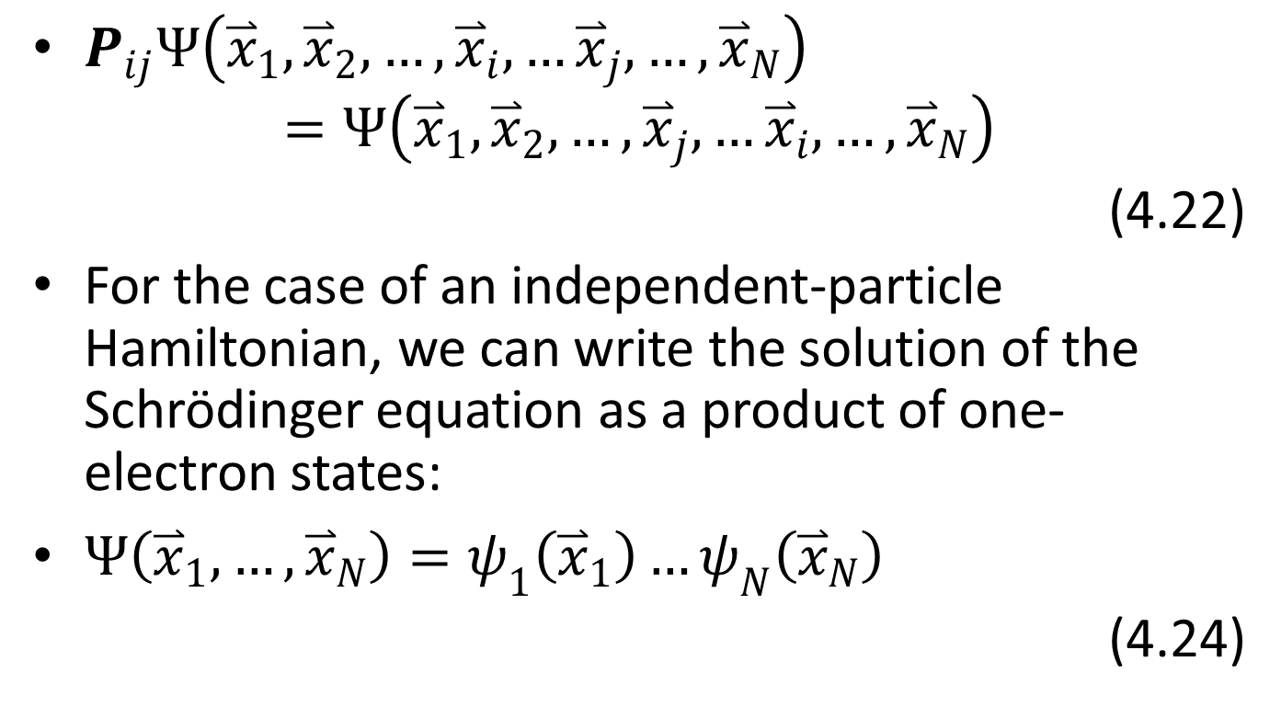

Particle-exchange operator, $P_{ij}$
$P_{ij}Ψ\left({\overset{⃑}{x}}_{1},{\overset{⃑}{x}}_{2},…,{\overset{⃑}{x}}_{i},…{\overset{⃑}{x}}_{j},…,{\overset{⃑}{x}}_{N}\right)$
$$=Ψ\left({\overset{⃑}{x}}_{1},{\overset{⃑}{x}}_{2},…,{\overset{⃑}{x}}_{j},…{\overset{⃑}{x}}_{i},…,{\overset{⃑}{x}}_{N}\right)$$
(4.22)
For the case of an independent-particle Hamiltonian, we can write the solution of the Schrödinger equation as a product of one-electron states:
$Ψ\left({\overset{⃑}{x}}_{1},…,{\overset{⃑}{x}}_{N}\right)=ψ_{1}\left({\overset{⃑}{x}}_{1}\right)…ψ_{N}\left({\overset{⃑}{x}}_{N}\right)$
(4.24)

Slide 18
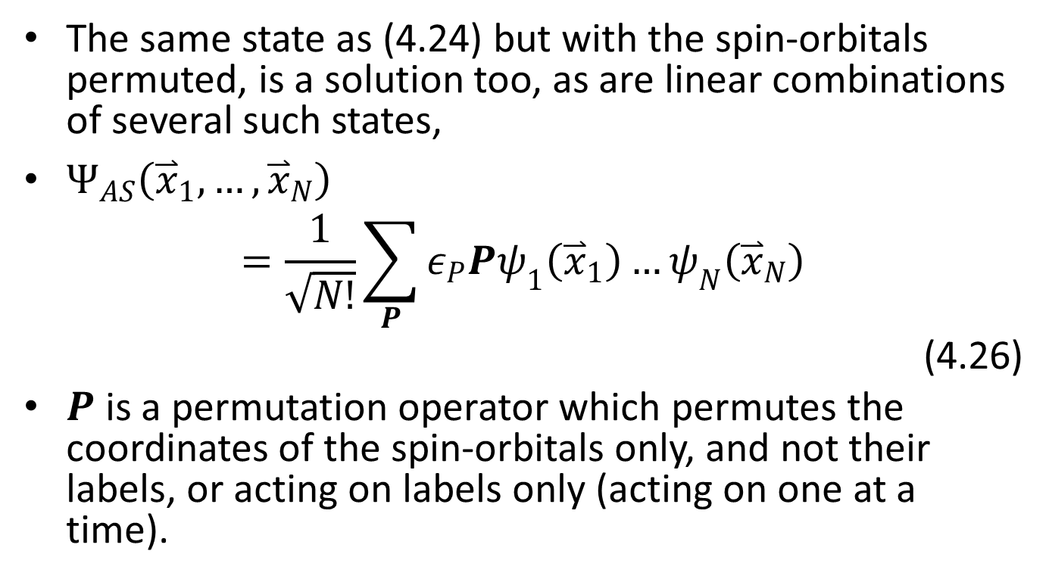
Spin-orbitals permuted
The same state as (4.24) but with the spin-orbitals permuted, is a solution too, as are linear combinations of several such states,
$Ψ_{AS}\left({\overset{⃑}{x}}_{1},…,{\overset{⃑}{x}}_{N}\right)$
$$=\frac{1}{\sqrt{N!}}\sum_{P}{ε_{P}Pψ_{1}\left({\overset{⃑}{x}}_{1}\right)…ψ_{N}\left({\overset{⃑}{x}}_{N}\right)}$$
(4.26)
$P$ is a permutation operator which permutes the coordinates of the spin-orbitals only, and not their labels, or acting on labels only (acting on one at a time).

Slide 19
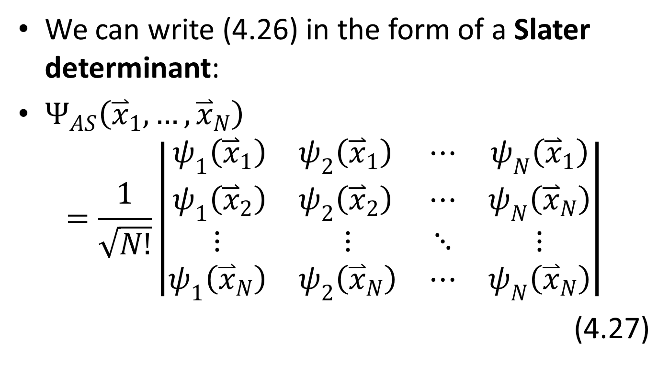
Slater determinant
We can write (4.26) in the form of a Slater determinant:
$Ψ_{AS}\left({\overset{⃑}{x}}_{1},…,{\overset{⃑}{x}}_{N}\right)$
$$=\frac{1}{\sqrt{N!}}\left|\begin{matrix}\begin{matrix}ψ_{1}\left({\overset{⃑}{x}}_{1}\right) & ψ_{2}\left({\overset{⃑}{x}}_{1}\right) \\ ψ_{1}\left({\overset{⃑}{x}}_{2}\right) & ψ_{2}\left({\overset{⃑}{x}}_{2}\right)\end{matrix} & \begin{matrix}⋯ & ψ_{N}\left({\overset{⃑}{x}}_{1}\right) \\ ⋯ & ψ_{N}\left({\overset{⃑}{x}}_{N}\right)\end{matrix} \\ \begin{matrix}⋮ & ⋮ \\ ψ_{1}\left({\overset{⃑}{x}}_{N}\right) & ψ_{2}\left({\overset{⃑}{x}}_{N}\right)\end{matrix} & \begin{matrix}⋱ & ⋮ \\ ⋯ & ψ_{N}\left({\overset{⃑}{x}}_{N}\right)\end{matrix}\end{matrix}\right|$$
(4.27)

Slide 20
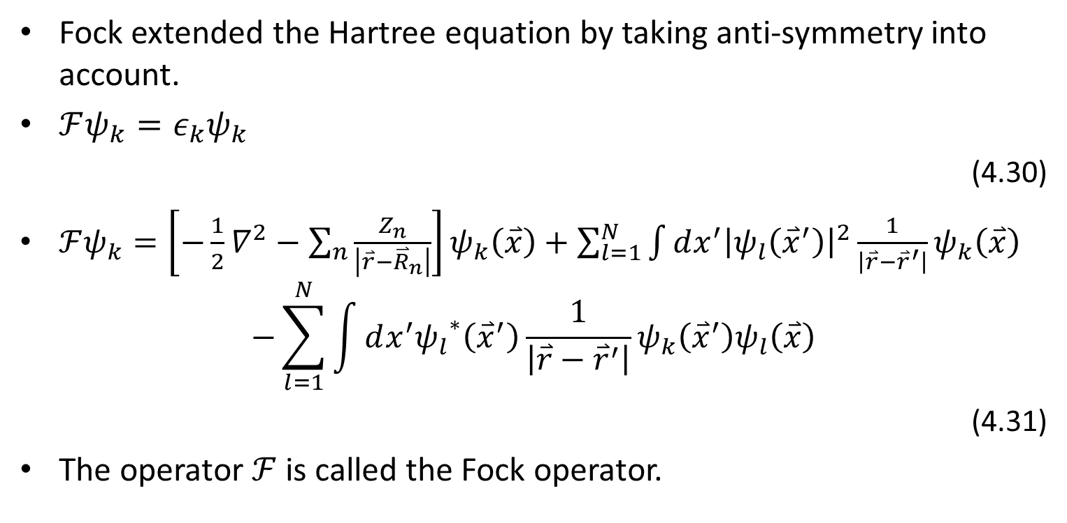
Hartree equation
Fock extended the Hartree equation by taking anti-symmetry into account.
$ℱψ_{k}=ε_{k}ψ_{k}$
(4.30)
$ℱψ_{k}=\left[−\frac{1}{2}∇^{2}−\sum_{n}{\frac{Z_{n}}{\left|\overset{⃑}{r}−{\overset{⃑}{R}}_{n}\right|}}\right]ψ_{k}\left(\overset{⃑}{x}\right)+\sum_{l=1}^{N}{\int{dx^{′}{\left|ψ_{l}\left({\overset{⃑}{x}}^{′}\right)\right|}^{2}\frac{1}{\left|\overset{⃑}{r}−{\overset{⃑}{r}}^{′}\right|}}}ψ_{k}\left(\overset{⃑}{x}\right)$
$$−\sum_{l=1}^{N}{\int{dx^{′}{ψ_{l}}^{∗}\left({\overset{⃑}{x}}^{′}\right)\frac{1}{\left|\overset{⃑}{r}−{\overset{⃑}{r}}^{′}\right|}}}ψ_{k}\left({\overset{⃑}{x}}^{′}\right)ψ_{l}\left(\overset{⃑}{x}\right)$$
(4.31)
The operator $ℱ$ is called the Fock operator.

Slide 21
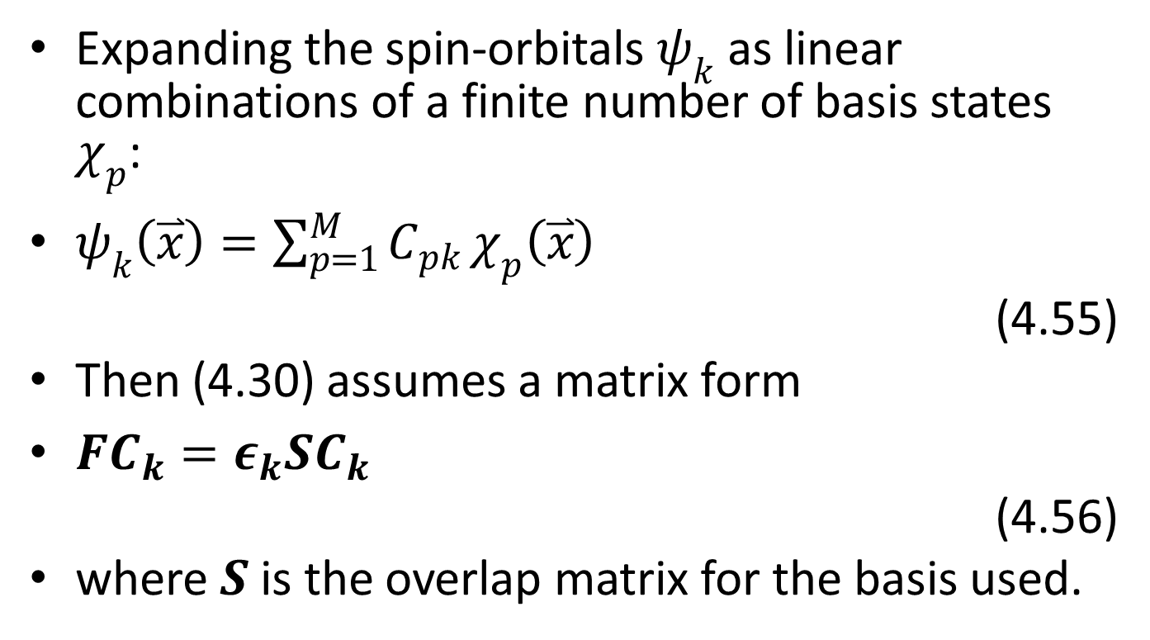

Linear combinations of a finite number of basis states $χ_{p}$
Expanding the spin-orbitals $ψ_{k}$ as linear combinations of a finite number of basis states $χ_{p}$:
$ψ_{k}\left(\overset{⃑}{x}\right)=\sum_{p=1}^{M}{C_{pk}}χ_{p}\left(\overset{⃑}{x}\right)$
(4.55)
Then (4.30) assumes a matrix form
$FC_{k}=ε_{k}SC_{k}$
(4.56)
where $S$ is the overlap matrix for the basis used.

Slide 22
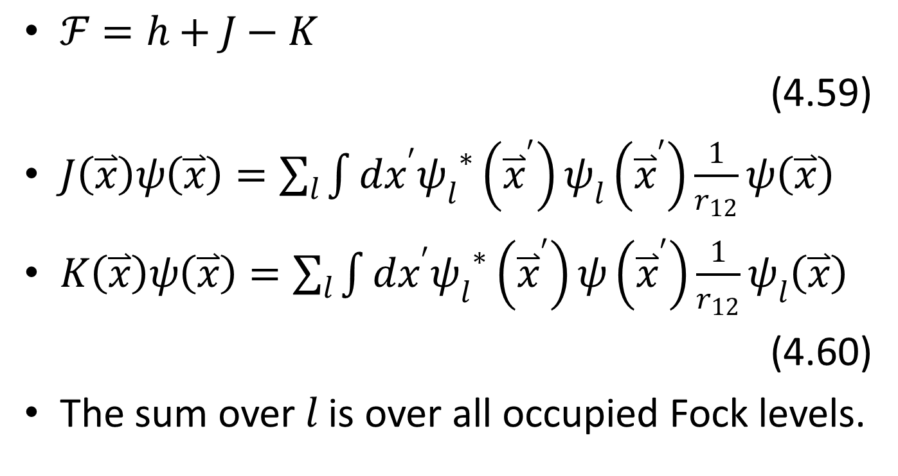
General form of the Fock operator
$ℱ=h+J−K$
(4.59)
$J\left(\overset{⃑}{x}\right)ψ\left(\overset{⃑}{x}\right)=\sum_{l}{\int{dx^{′}{ψ_{l}}^{∗}\left({\overset{⃑}{x}}^{′}\right)ψ_{l}\left({\overset{⃑}{x}}^{′}\right)\frac{1}{r_{12}}}}ψ\left(\overset{⃑}{x}\right)$
$K\left(\overset{⃑}{x}\right)ψ\left(\overset{⃑}{x}\right)=\sum_{l}{\int{dx^{′}{ψ_{l}}^{∗}\left({\overset{⃑}{x}}^{′}\right)ψ\left({\overset{⃑}{x}}^{′}\right)\frac{1}{r_{12}}}}ψ_{l}\left(\overset{⃑}{x}\right)$
(4.60)
The sum over $l$ is over all occupied Fock levels.

Slide 23
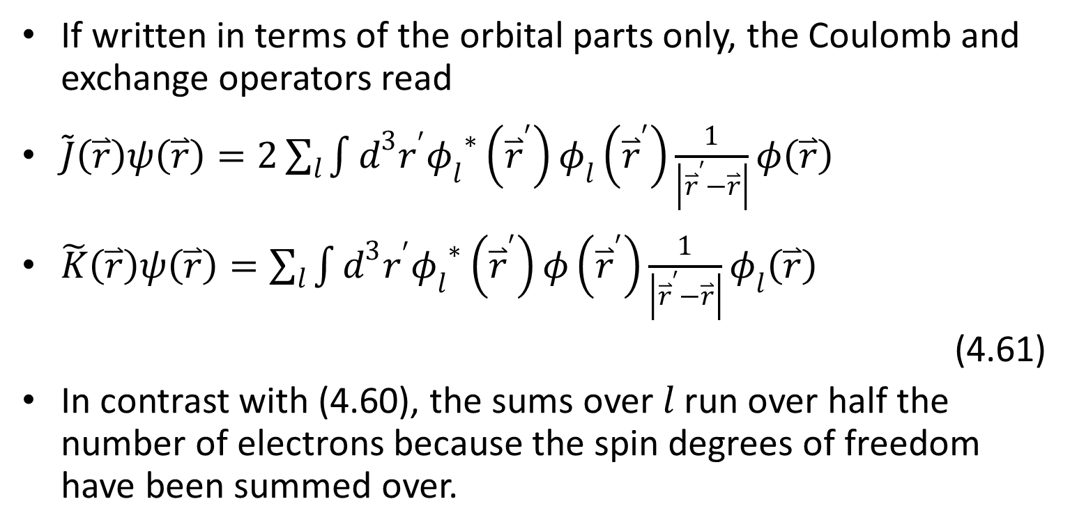
If written in terms of the orbital parts only, the Coulomb and exchange operators read
$\tilde{J}\left(\overset{⃑}{r}\right)ψ\left(\overset{⃑}{r}\right)=2\sum_{l}{\int{d^{3}r^{′}{φ_{l}}^{∗}\left({\overset{⃑}{r}}^{′}\right)φ_{l}\left({\overset{⃑}{r}}^{′}\right)\frac{1}{\left|{\overset{⃑}{r}}^{′}−\overset{⃑}{r}\right|}}}φ\left(\overset{⃑}{r}\right)$
$\tilde{K}\left(\overset{⃑}{r}\right)ψ\left(\overset{⃑}{r}\right)=\sum_{l}{\int{d^{3}r^{′}{φ_{l}}^{∗}\left({\overset{⃑}{r}}^{′}\right)φ\left({\overset{⃑}{r}}^{′}\right)\frac{1}{\left|{\overset{⃑}{r}}^{′}−\overset{⃑}{r}\right|}}}φ_{l}\left(\overset{⃑}{r}\right)$
(4.61)
In contrast with (4.60), the sums over $l$ run over half the number of electrons because the spin degrees of freedom have been summed over.

Slide 24
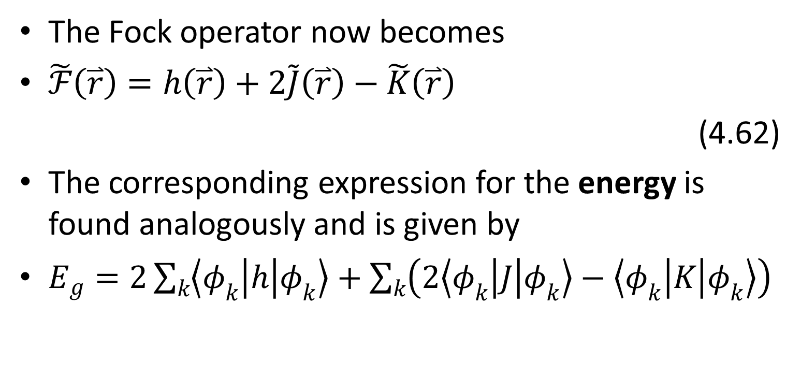
Fock operator
The Fock operator now becomes
$\tilde{ℱ}\left(\overset{⃑}{r}\right)=h\left(\overset{⃑}{r}\right)+2\tilde{J}\left(\overset{⃑}{r}\right)−\tilde{K}\left(\overset{⃑}{r}\right)$
(4.62)
The corresponding expression for the energy is found analogously and is given by
$E_{g}=2\sum_{k}{\left\langle φ_{k} | h | φ_{k}\right\rangle }+\sum_{k}{\left(2\left\langle φ_{k} | J | φ_{k}\right\rangle −\left\langle φ_{k} | K | φ_{k}\right\rangle \right)}$

Slide 25
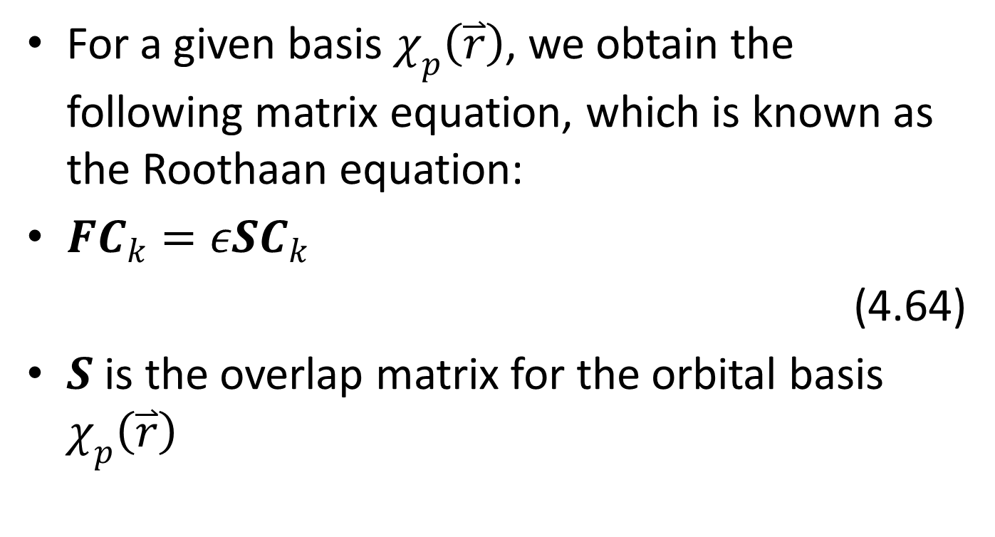
Roothaan equation
For a given basis $χ_{p}\left(\overset{⃑}{r}\right)$, we obtain the following matrix equation, which is known as the Roothaan equation:
$FC_{k}=εSC_{k}$
(4.64)
$S$ is the overlap matrix for the orbital basis $χ_{p}\left(\overset{⃑}{r}\right)$

Slide 26
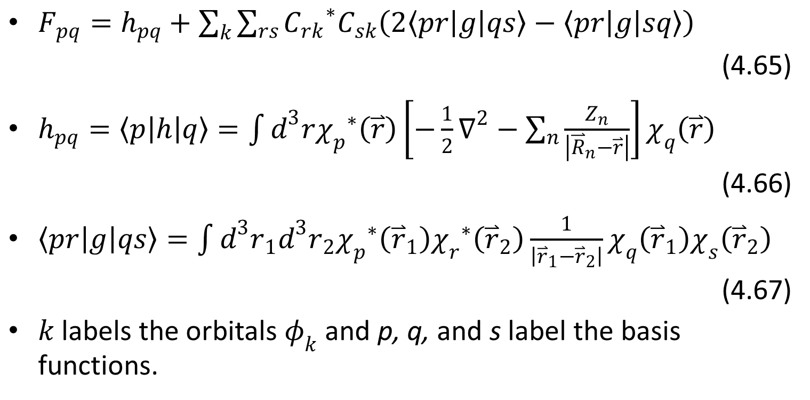

Matrix $F$
$F_{pq}=h_{pq}+\sum_{k}{\sum_{rs}{{C_{rk}}^{∗}C_{sk}\left(2\left\langle pr | g | qs\right\rangle −\left\langle pr | g | sq\right\rangle \right)}}$
(4.65)
$h_{pq}=\left\langle p | h | q\right\rangle =\int{d^{3}r{χ_{p}}^{∗}\left(\overset{⃑}{r}\right)\left[−\frac{1}{2}∇^{2}−\sum_{n}{\frac{Z_{n}}{\left|{\overset{⃑}{R}}_{n}−\overset{⃑}{r}\right|}}\right]χ_{q}\left(\overset{⃑}{r}\right)}$
(4.66)
$\left\langle pr | g | qs\right\rangle =\int{d^{3}r_{1}d^{3}r_{2}{χ_{p}}^{∗}\left({\overset{⃑}{r}}_{1}\right){χ_{r}}^{∗}\left({\overset{⃑}{r}}_{2}\right)\frac{1}{\left|{\overset{⃑}{r}}_{1}−{\overset{⃑}{r}}_{2}\right|}χ_{q}\left({\overset{⃑}{r}}_{1}\right)χ_{s}\left({\overset{⃑}{r}}_{2}\right)}$
(4.67)
$k$ labels the orbitals $φ_{k}$ and p, q, and s label the basis functions.

Slide 27
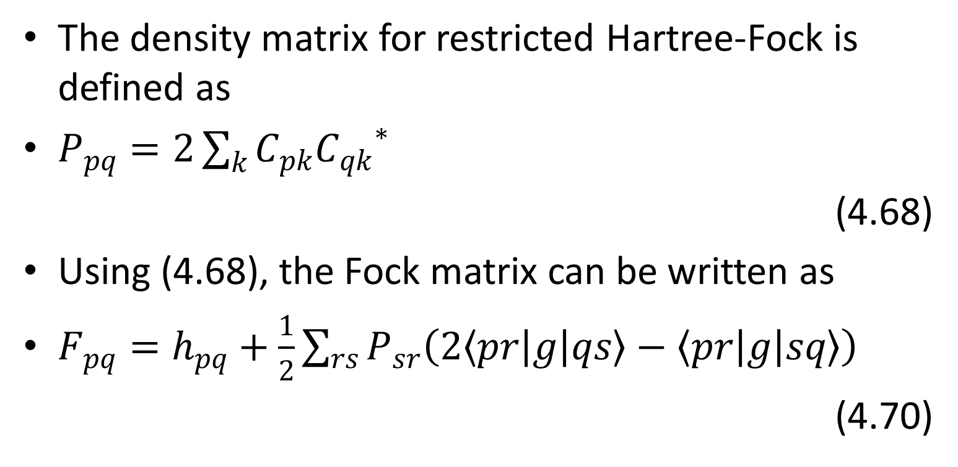
Density matrix
The density matrix for restricted Hartree-Fock is defined as
$P_{pq}=2\sum_{k}{C_{pk}{C_{qk}}^{∗}}$
(4.68)
Using (4.68), the Fock matrix can be written as
$F_{pq}=h_{pq}+\frac{1}{2}\sum_{rs}{P_{sr}\left(2\left\langle pr | g | qs\right\rangle −\left\langle pr | g | sq\right\rangle \right)}$
(4.70)

Slide 28

Energy
$E=\sum_{pq}{P_{pq}h_{pq}}$
$$+\frac{1}{2}\sum_{pqrs}{P_{pq}P_{sr}\left(\left\langle pr | g | qs\right\rangle −\frac{1}{2}\left\langle pr | g | sq\right\rangle \right)}$$
(4.71)

Slide 29
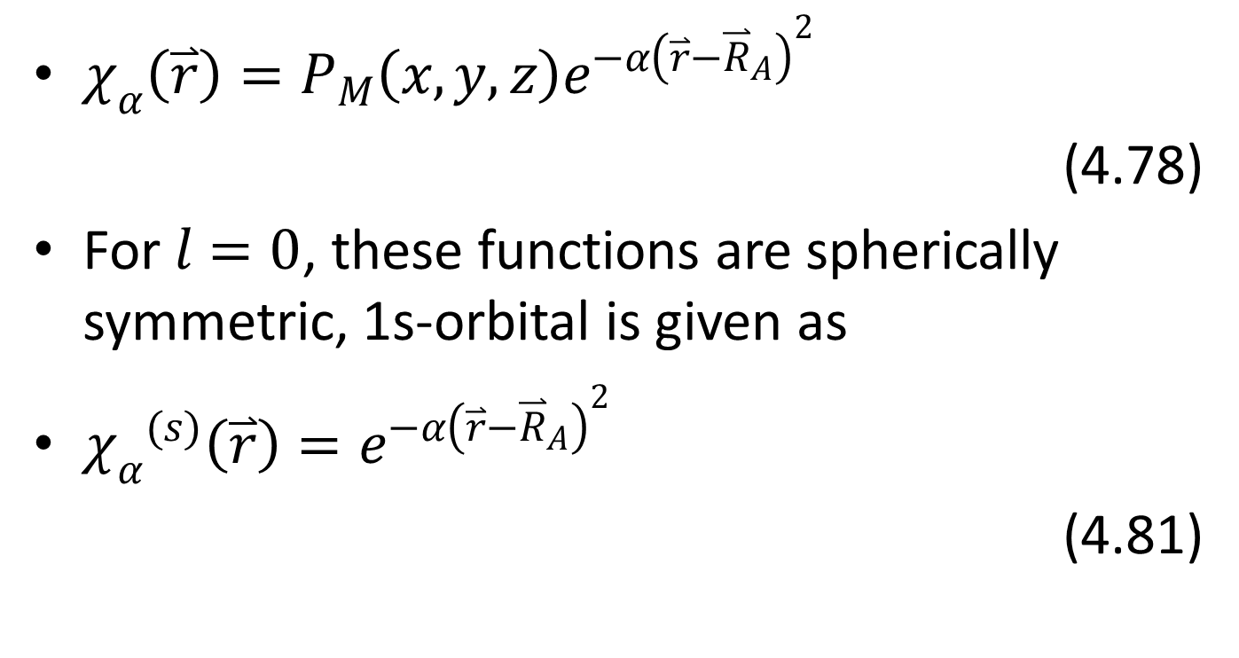
Gaussian function
$χ_{α}\left(\overset{⃑}{r}\right)=P_{M}\left(x,y,z\right)e^{−α{\left(\overset{⃑}{r}−{\overset{⃑}{R}}_{A}\right)}^{2}}$
(4.78)
For $l=0$, these functions are spherically symmetric, 1s-orbital is given as
${χ_{α}}^{(s)}\left(\overset{⃑}{r}\right)=e^{−α{\left(\overset{⃑}{r}−{\overset{⃑}{R}}_{A}\right)}^{2}}$
(4.81)

Slide 30
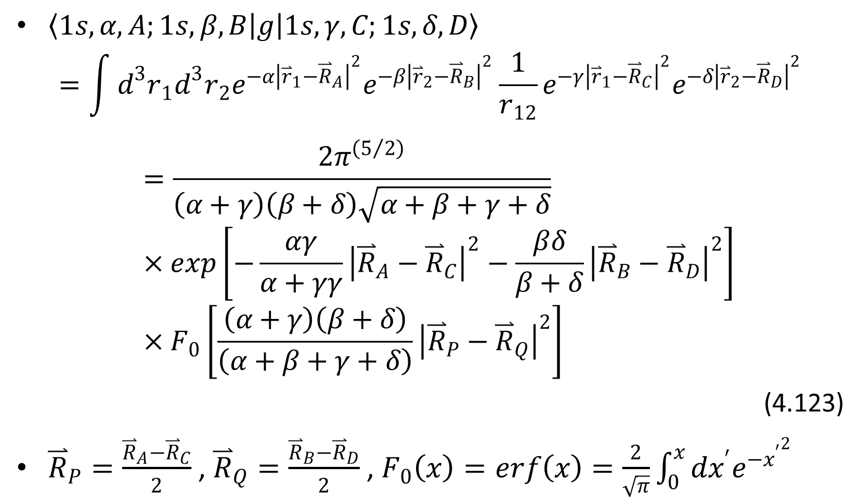
The two-electron integral
$\left\langle 1s,α,A;1s,β,B | g | 1s,γ,C;1s,δ,D\right\rangle$
$$=\int{d^{3}r_{1}d^{3}r_{2}e^{−α{\left|{\overset{⃑}{r}}_{1}−{\overset{⃑}{R}}_{A}\right|}^{2}}e^{−β{\left|{\overset{⃑}{r}}_{2}−{\overset{⃑}{R}}_{B}\right|}^{2}}\frac{1}{r_{12}}e^{−γ{\left|{\overset{⃑}{r}}_{1}−{\overset{⃑}{R}}_{C}\right|}^{2}}e^{−{δ\left|{\overset{⃑}{r}}_{2}−{\overset{⃑}{R}}_{D}\right|}^{2}}}=\frac{2π^{\left(5/2\right)}}{\left(α+γ\right)\left(β+δ\right)\sqrt{α+β+γ+δ}}×exp\left[−\frac{αγ}{α+γγ}{\left|{\overset{⃑}{R}}_{A}−{\overset{⃑}{R}}_{C}\right|}^{2}−\frac{βδ}{β+δ}{\left|{\overset{⃑}{R}}_{B}−{\overset{⃑}{R}}_{D}\right|}^{2}\right]×F_{0}\left[\frac{\left(α+γ\right)\left(β+δ\right)}{\left(α+β+γ+δ\right)}{\left|{\overset{⃑}{R}}_{P}−{\overset{⃑}{R}}_{Q}\right|}^{2}\right]$$
(4.123)
${\overset{⃑}{R}}_{P}=\frac{{\overset{⃑}{R}}_{A}−{\overset{⃑}{R}}_{C}}{2}$ , ${\overset{⃑}{R}}_{Q}=\frac{{\overset{⃑}{R}}_{B}−{\overset{⃑}{R}}_{D}}{2}$ , $F_{0}\left(x\right)=erf\left(x\right)=\frac{2}{\sqrt{π}}\int_{0}^{x}{dx^{′}e^{−{x^{′}}^{2}}}$

